Slide 1

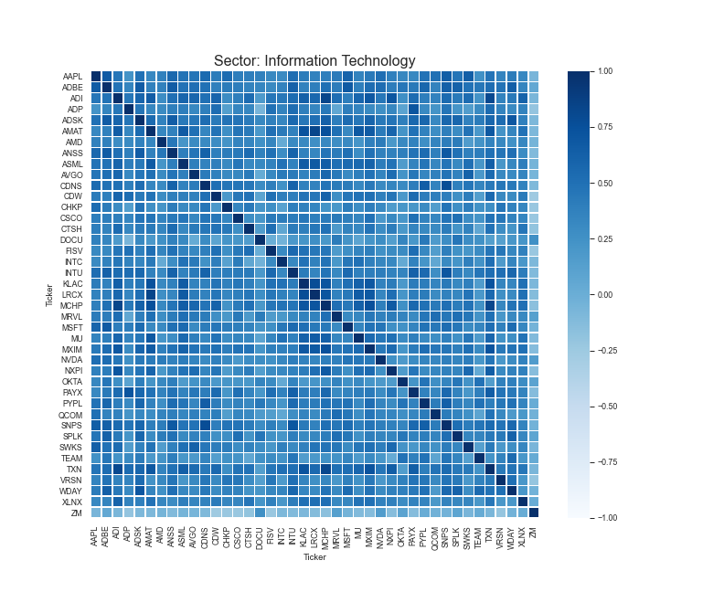
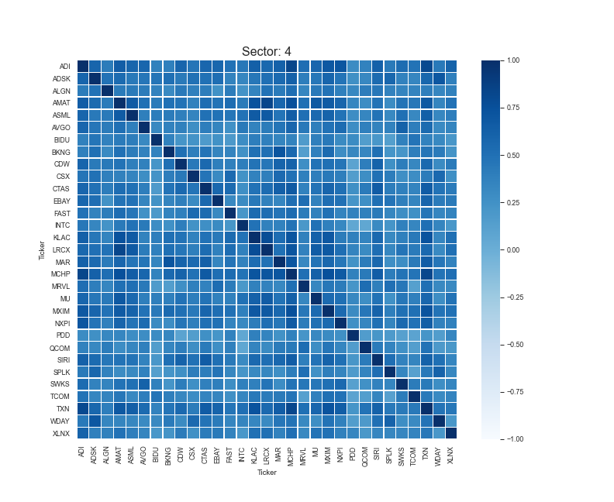
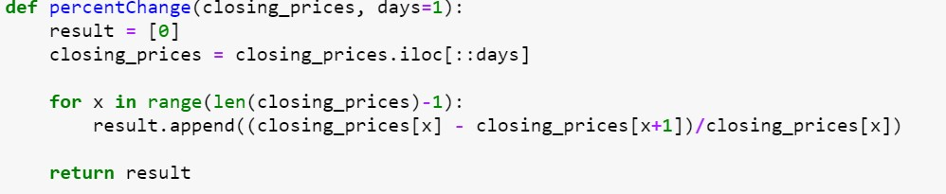
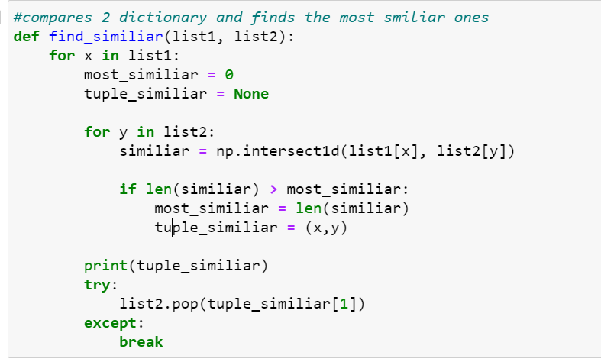
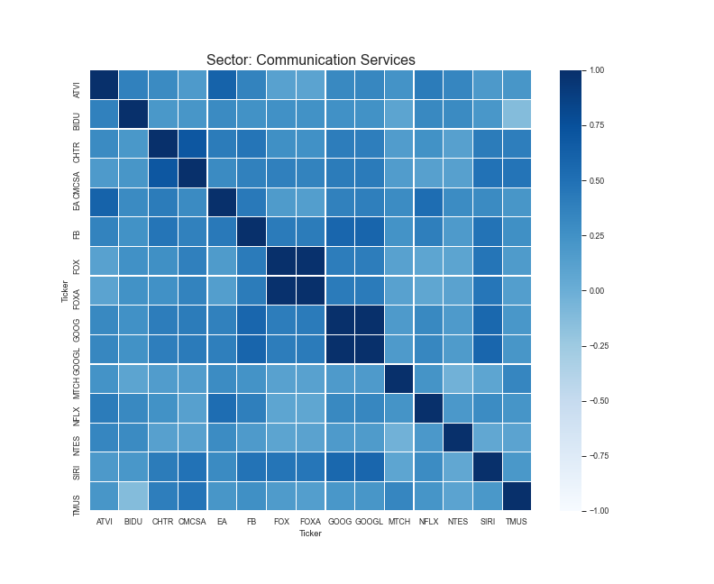
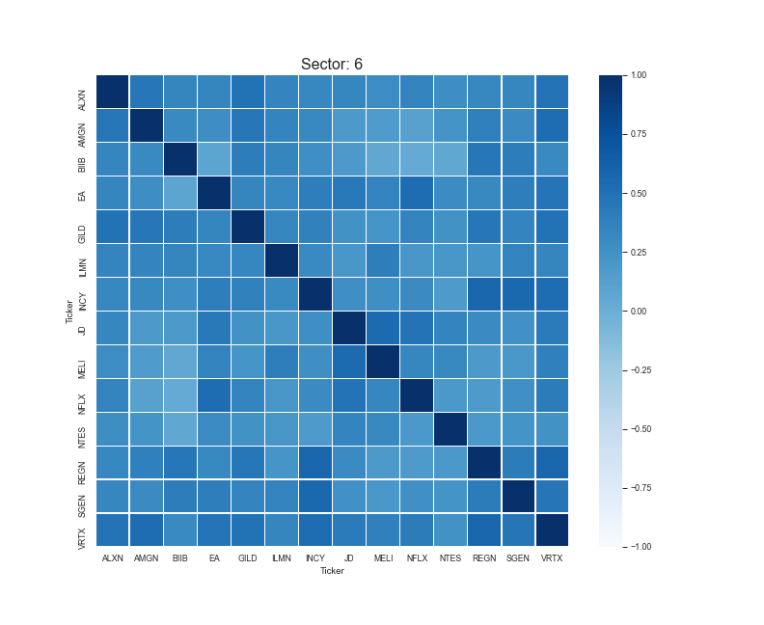
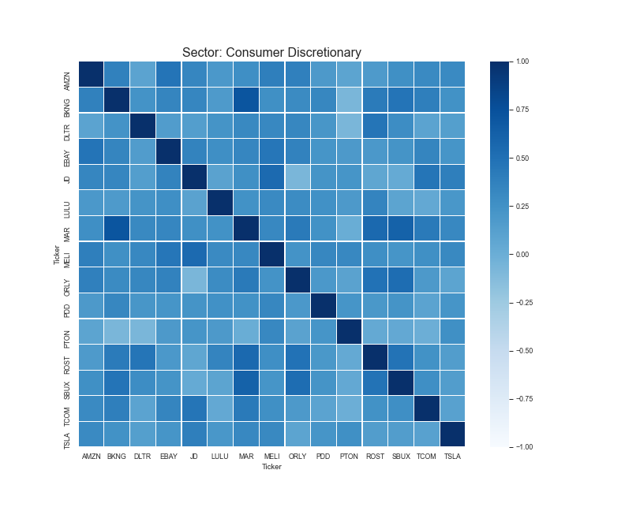
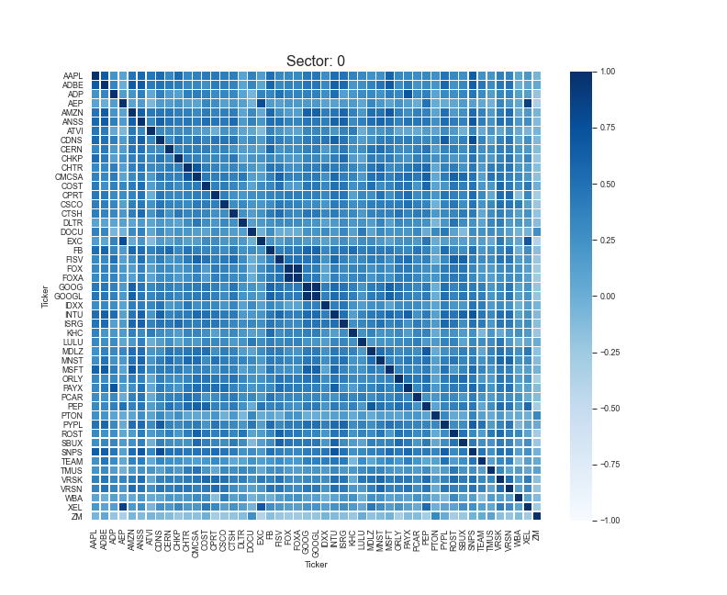
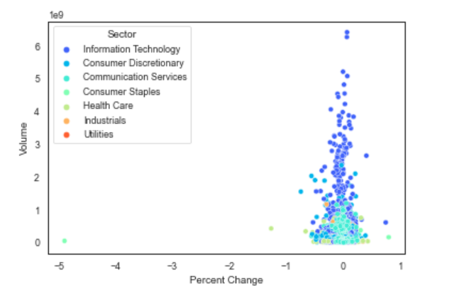
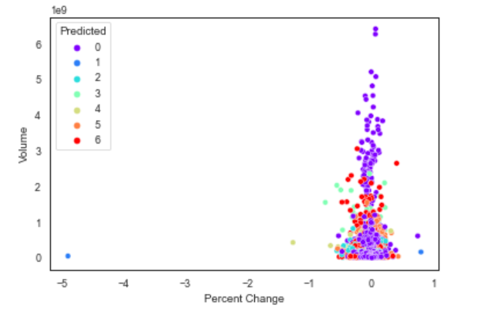
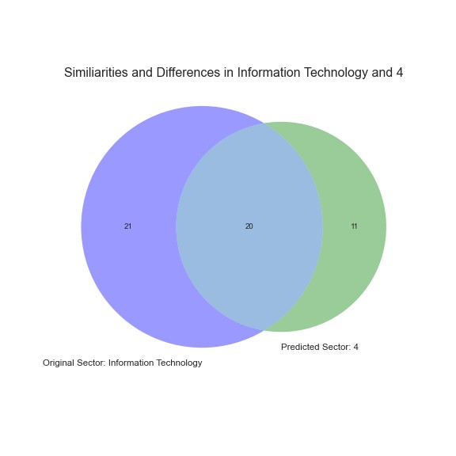
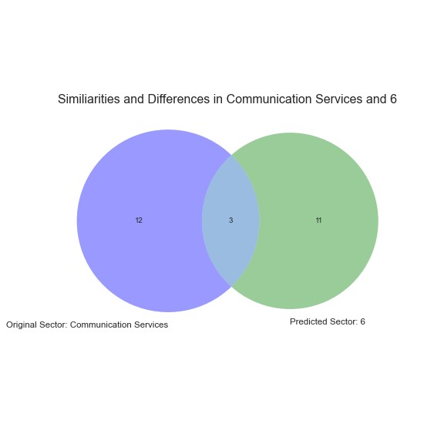
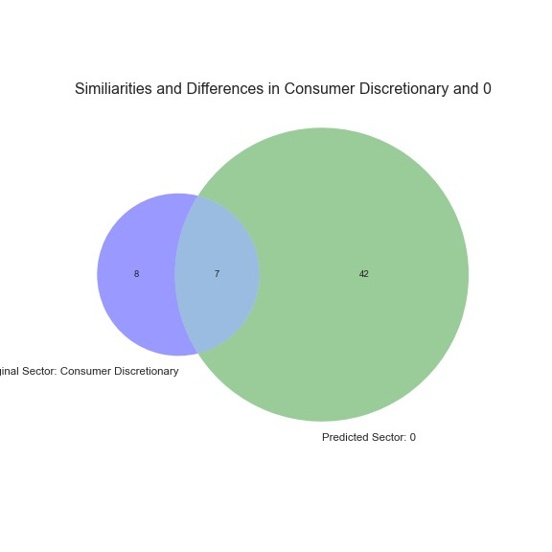
Sector Regrouping for Invesco QQQ ETF based on K-Mean Clustering Algorithm
Topu Saha, Weikang Kong, Nan Wang
New Jersey City University
Introduction
Invesco QQQ holds 100 stocks which are allocated to seven sectors, Information Technology, Communication Services, Consumer Discretionary, Health Care, Consumer Staple, Industrials, and Utilities.
In 2021, classifying stocks into sectors are getting more confusing as companies are evolving and are serving multiple industries.
We use K-Mean clustering algorithm on the holdings in the QQQ exchange-traded fund to re-cluster the stocks based on performance.
The correlations between the predicted sectors and their stocks vs. the original sectors and their stocks will be compared, analyzed, and visualized using Python’s Pandas, Financial, Machine Learning, and visualization libraries
Methodology
Download all data from online
Pre-Process Data
Create a Pandas DataFrame with all the needed information
Ticker, Monthly Closing Prices, Original Sector
Delete null values
Generate Monthly Percent Change from the closing prices
Transform into a Pivot plot
Run K-Means algorithm on Data
Specify how many clusters
Fed the model data from the stocks
Run the Model on the stocks to classify them
Visualize Results into scatterplot, and heatmaps
Heatmaps of the top three sectors and their correlation values
Results
Our k-means algorithm was able to cluster the stocks in the QQQ fund differently than what it originally had.
The differences are displayed using pie charts, and scatterplots.
When comparing the heatmaps of the three largest sectors in the original and predicted data, we see a slight positive difference between the Information Technology sector and its corresponding predicted sector.
The same is true for the Consumer Discretionary sector
However false for the Communication Services sector.
In future testing, we plan to fed more data into our model for which we need a more powerful computer to do.
With more data in our model, we hope to see a stronger difference in correlations between sectors.
We can also use machine learning to predict the stock price in the future and compare the returns between predicted and original sectors.
Scatterplot Comparison
Venn Diagram Comparison
Tickers that k-Means predicted that should be in Information Technology are the following
['ALGN' 'BIDU' 'BKNG' 'CSX' 'CTAS' 'EBAY’ 'FAST' 'MAR' 'PDD' 'SIRI' 'TCOM']
Tickers that k-Means predicted that should be in Communication Services are the following
['AAPL' 'ADBE' 'ADP' 'AEP' 'ANSS' 'ATVI' 'CDNS' 'CERN' 'CHKP' 'CHTR' 'CMCSA' 'COST’ 'CPRT' 'CSCO' 'CTSH' 'DOCU' 'EXC' 'FB' 'FISV' 'FOX' 'FOXA' 'GOOG' 'GOOGL' 'IDXX' 'INTU’ ‘ISRG' 'KHC' 'MDLZ' 'MNST' 'MSFT' 'PAYX' 'PCAR' 'PEP’
'PYPL' 'SNPS' 'TEAM' 'TMUS’ 'VRSK' 'VRSN' 'WBA' 'XEL' 'ZM']
Tickers that k-Means predicted that should be in Consumer Discretionary are the following
['ALXN' 'AMGN' 'BIIB' 'GILD' 'ILMN' 'INCY' 'JD' 'MELI' 'REGN' 'SGEN' 'VRTX']
Acknowledgment
Thank you to New Jersey City University for allowing me to be involved in the Summer Stem Internship
I would also like to give thanks to my mentor Dr. Nan Wang for guiding me through this experience and Weikang Kong for developing the website for this research project.
I would like to acknowledge the US Education Department Title III Part F HSI-STEM Grant # P031C160155 and US Education Department Title V DHSI Grant # P031S200124 for their generous grant offers.

